Slide 1

Database Systems
Topic 6 :
Database Normalization
(数据库规范化)
Reference: https://www.youtube.com/watch?v=IwswNIZ_PSg
(Normalization)

Slide 2
Unit 6 : Normalization in Database
Objective :
At the end of this unit, you should be able to:
  describe modification anomalies in un-normalized relations.
  interpret the first three normal forms (NF) in normalization process.
  apply normal forms (NF) in normalizing the relations.

Slide 3
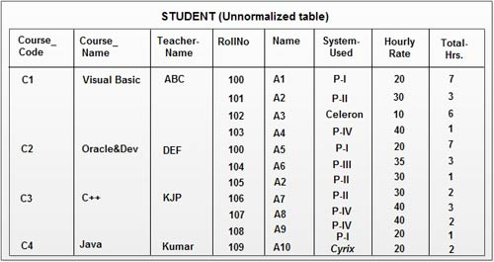
Un-Normalization Relation
Un-normalized relation (table) inherits problems!
insertion, update and deletion of data
C1
If both ‘CourseCode’ & ‘RollNo’ is unknown, it cannot determine the ‘TotalHrs’.
- e.g. records with ‘RollNo’ :101, 103, 105 & 107 – incomplete insertion.
If record with ‘CourseCode’ : 100 is deleted, records with ‘RollNo’ : 101 & 103 will be untraceable of ‘Course_code’, ‘Course_Name’ and ‘Teacher_Name’.
If there are multiple ‘RollNo’ :100 to update, how to ensure all ‘System_Used’ & ‘HourlyRate’ to be updated?
Source: http://www.info.teradata.com

Slide 4
ANOMALIES
Modification Anomalies
INSERTION
DELETION
Un-normalized relations are susceptible to experience 3 types of modification anomalies; namely:
Insertion anomaly
  Difficulties in inserting data into a relation
Update anomaly
  Difficulties in modifying data in a relation
Deletion anomaly
  Difficulties in deleting data from a relation
UPDATE
What is the impact ?
These anomalies will induce undesirable side-effects (e.g. inconsistent dependency data) in database design.

Slide 5
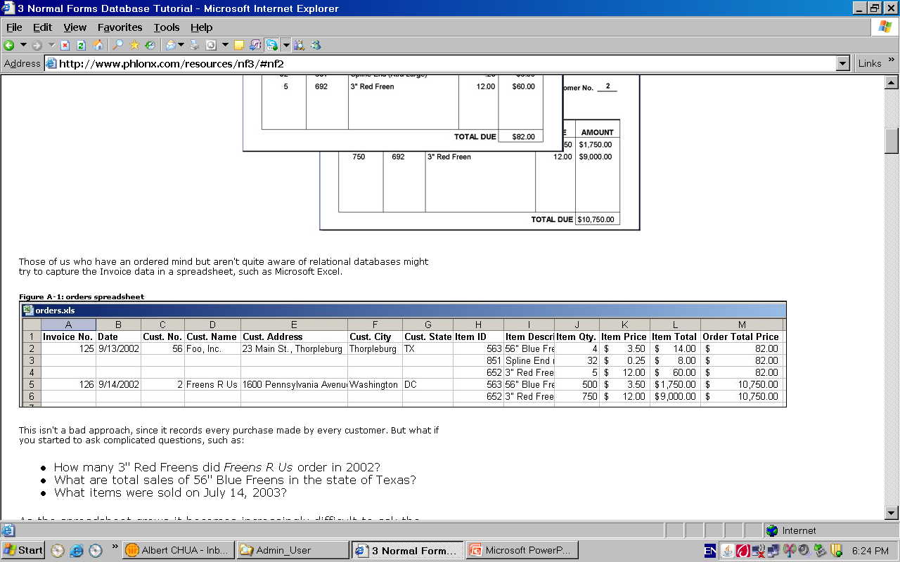
1. What is Insertion Anomaly ?
An insertion anomaly is a failure to insert information about a new database entry into ALL the relevant tuples in the database.
Example 1 : Un- normalized table
Deletion
These anomalies will induce undesirable side-effects (e.g. inconsistent dependency data) in database design.
?? ?? ?? ?? ??
(Incomplete inserted record )
Inserted partial record only)
When inserting an item details : ‘Item Description’, ‘Item Qty’, ‘Price’, ‘Item Total’ & ‘Order Total Price’ into the un-normalized table, there is no information about ‘Invoice No.’, ‘Date’, … ‘Cust City’ & ‘Cust State’. Thus, it cannot produces a complete record.

Slide 6
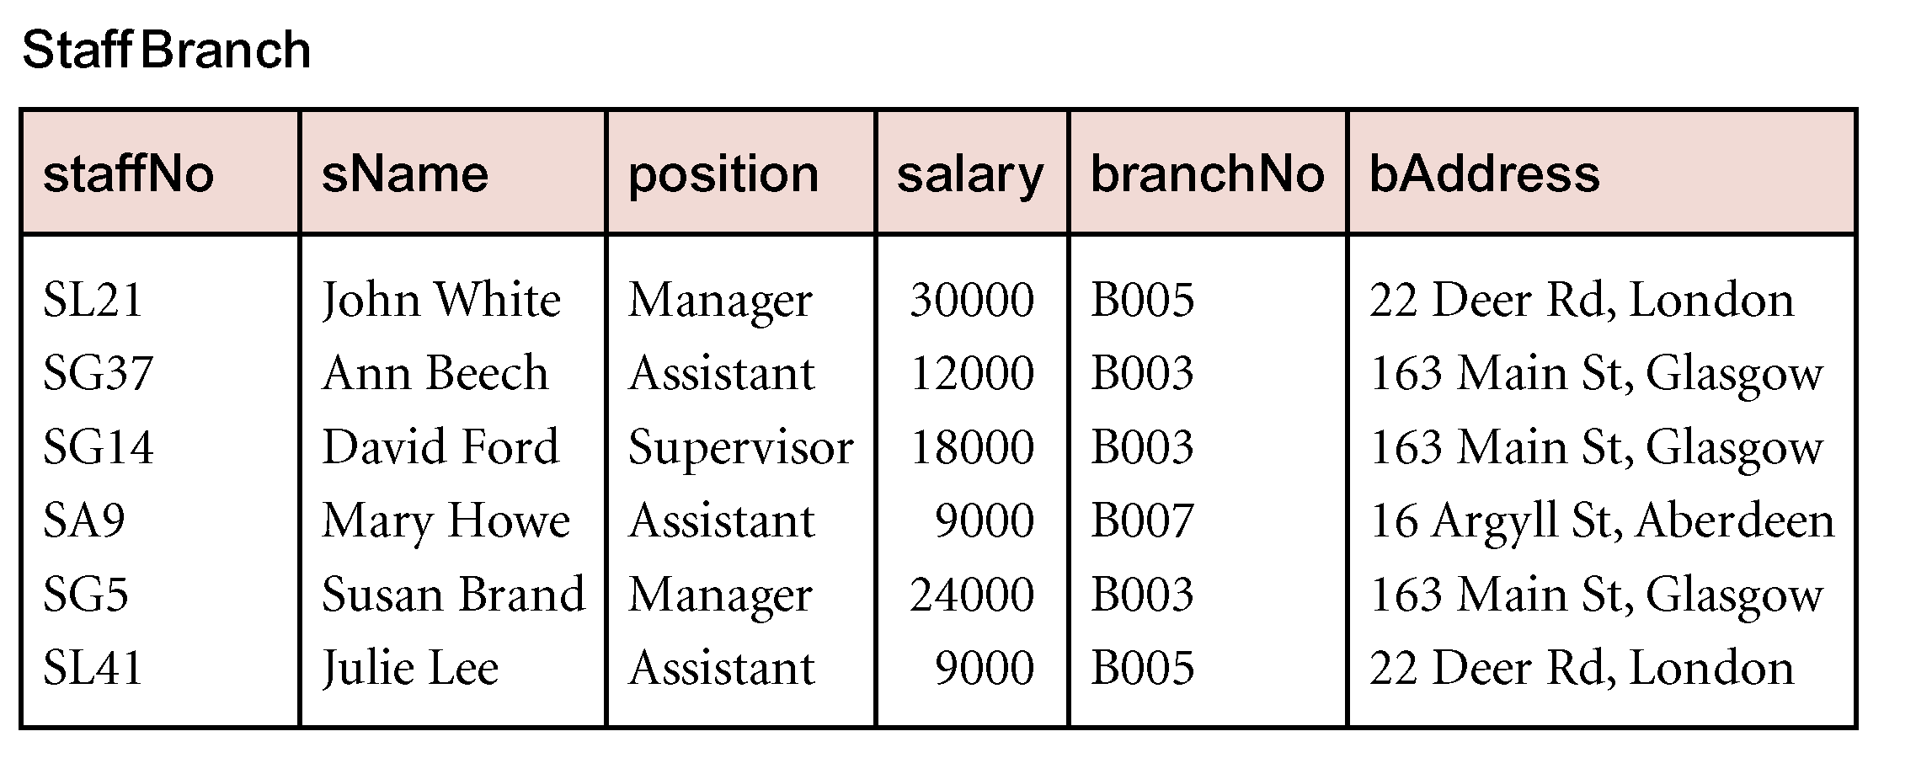
Insertion Anomaly
In this example, insertion anomaly occurs when inserting a new staff record or a new branch.
Figure 1- Table with redundant data
When inserting a new staff member but without a designating branch.
SG99 | Michael | Designer | 3000 | Null | Null
When inserting a new branch with no posted staff.
Null | Null | Null | Null | B008 | 33 Clarence Road
(Incomplete record for insertion – Insertion anomaly)
Notes:
Incomplete record being created in a table if only partially completed set of data is being entered into a table with insertion anomaly.

Slide 7
2. What is Update Anomaly ?
Update anomaly occurs when those updating records in the table had been updated partially (some got ‘missed out’ & resulted in partial update), thus resulting in data inconsistency and redundancy.
(The same branch records to be updated)

Slide 8
Update Anomaly
In this example, update anomaly occurs when updating affected records.
Figure 1- Table with redundant data
Redundant data that may lead to update anomaly
(If bAddress to be updated to 180 Cambridge Road …… )
SG37 | Ann Beech | Assistant | 12000 | B003 | 180 Cambridge Road
SG14 | David Ford | Supervisor | 18000 | B003 | 180 Cambridge Road
SG5 | Susan Brand | Manager | 24000 | B003 | 163 Main St, Glasgow
(being left-out in the update)
(Incomplete update of record data for the same branch !)
Notes:
Inconsistent information among records could occur if not all records containing update anomalies in a table is updated. This is especially so for tables with redundant data among records.

Slide 9
3. What is Deletion Anomaly ?
Deletion anomaly occurs when a record from the table cannot be deleted because if by deleting it, it will lead to an unintentionally removal of the trace of other associated record.
There is only one record (SA9) with branchNo B007, deleting that record shall lose all relevant data for Branch B007 from the table.
Note: Deletion anomaly may link to the referential integrity constraint)
(Referential integrity constraint between PK and FK)
(Cascaded deletion by the imposed referential constraint)

Slide 10
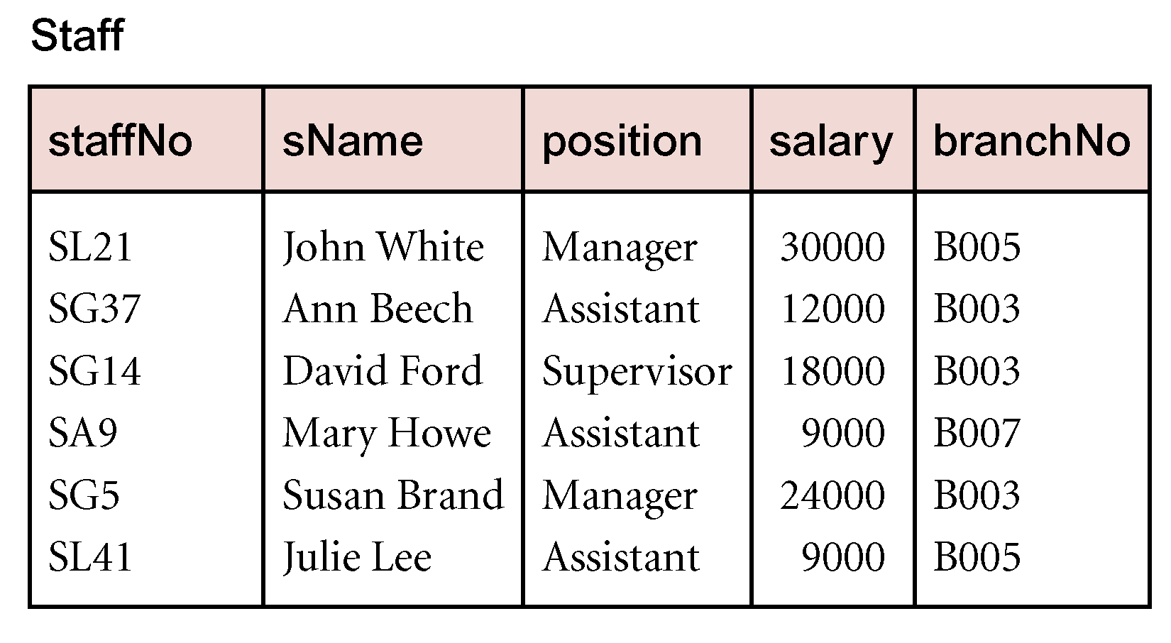
How did Normalization solve this problem?
Figure 1 – An un-Normalized relation
Before
After adopting Normalization technique, it splits an un-normalized relation into two separate relations with removed anomalies and with no data redundant. All insertion,
update or deletion of data, it needs to be done at ONLY ONE PLACE in the database
Figure 2 – Normalized Relations

Slide 11
Deletion Anomaly
In this example, deletion anomaly shall occur when:
Figure 1- Table with redundant data
(Delete Branch B007 leads to un-intended deletion of the only existing record ) : staffNo – ‘SA9’
SL21 | John White | Manager | 30000 | B005 | 22 Deer Rd, London
SG37 | Ann Beech | Assistant | 12000 | B003 | 163 Main St, Glasgow
SG14 | David Ford | Supervisor | 18000 | B003 | 163 Main St, Glasgow
SG5 | Susan | Manager | 24000 | B003 | 163 Main St, Glasgow
SG41 | Julie Lee | Assistant | 9000 | B005 | 22 Deer Rd, London
(Record SA9 unintentionally disappear from the relation)
Notes:
Some important information may be lost if a record containing delete anomaly in a table is deleted.

Slide 12
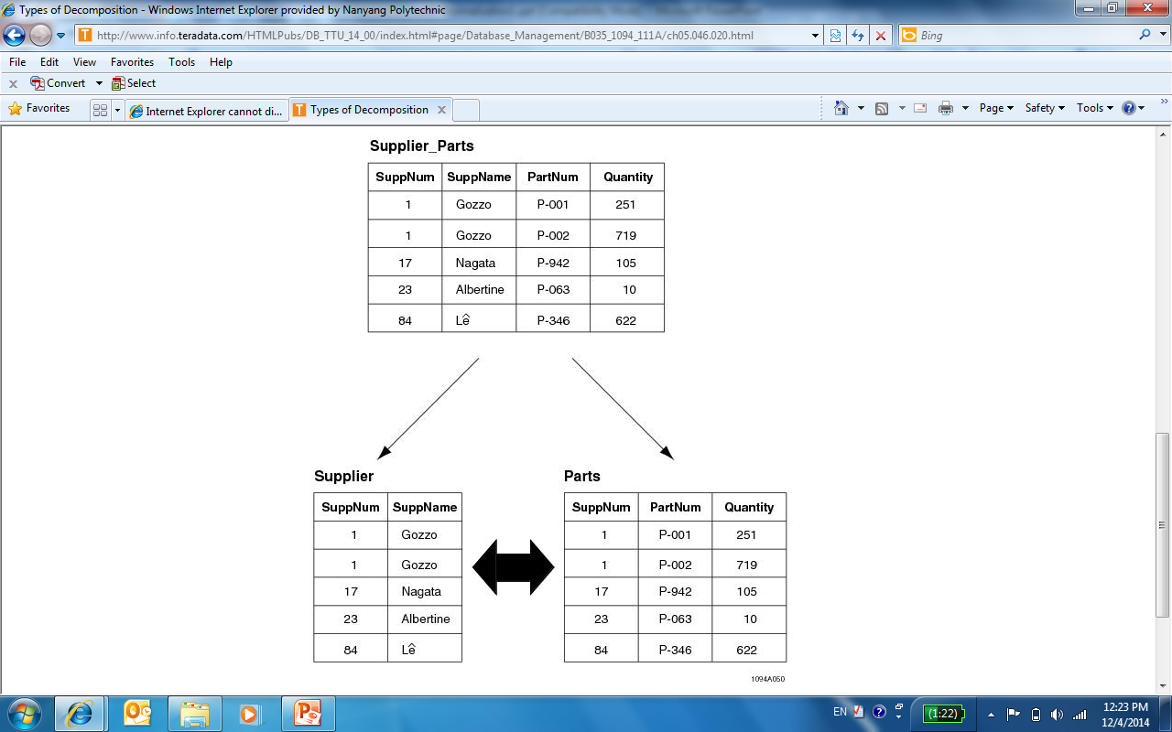
What is Normalization?
Normalization is a design process whereby a primitive data relation (table) is decomposed into more simpler relations that more precisely fit the relational model.
- All anomalies are highly undesirable, their occurrence constitutes corruption of the database.
Normalization process can eliminate these anomalies!
(Split)
(Un-normalized relation)

Slide 13
What can Normalization do?
Remove inconsistent dependency data (in database design)
Database designed based on ER model may have some amount of inconsistency, ambiguity and redundancy .
SuppNum | SuppName | PartNum | Quantity
1 | Gozzo | P-001 | 719
1 | Gocom | P-002 | 719
17 | Nagata | P-942 | 105
Before
(Typo error)
SuppNum | SuppName
1 | Gozzo
1 | Gocom
17 | Nagata
SuppNum | PartNum | Quantity
1 | P-001 | 719
1 | P-002 | 719
17 | P-942 | 105
After

Slide 14
What can Normalization do?
Remove redundancies :
The same data could appear in multiple records or relations).
SuppNum | SuppName | PartNum | Date_In
1 | Gozzo | P-001 | Mar-2018
1 | Gozzo | P-011 | Apr-2018
17 | Nagata | P-942 | Apr-2018
17 | Nagata | P-943 | May-2018
SuppNum | SuppName
1 | Gozzo
17 | Nagata
(This is just one of the normalized tables)
Hence, being able to remove inconsistency and redundancy in the database, normalization increases the clarity in organizing data in a database. It ensures data dependencies make sense.
Normalization can be adopted as a refinement process.

Slide 15
What can Normalization do?
Further refine ER modelling :
PURCHASE
DELIVERY
ItemID
SupplierID
Items
SuppClass
ItemCost
make
DeliverNo
ItemID
DateDeliver
StaffName
Phone
A modelled ERD
PURCHASE
1
Sometimes, even though the relation has been modelled, it still inherited “problems” – known as anomalies
ItemID | SupplierID | Items | SuppClass | ItemCost
P-01 | Supp1 | Printer | B | 550
P-02 | Supp2 | Projector | A | 2300
P-11 | Supp1 | Tonner | B | 120
P-22 | Supp2 | Bulbs | A | 60
DELIVERY
2
DeliverNO | ItemID | DateDeliver | StaffName | Phone
D1 | P-01 | 03-Jul | Sam | 91234567
D1 | P-11 | 04-Jul | Sam | 91234567
D2 | P-02 | 05-Jul | Tom | 87654321
D2 | P-22 | 06-Jul | Tom | 87654321

Slide 16
What can Normalization do?
1
To normalize relation: PURCHASE
PURCHASE
ItemNO | SupplierID | Items | SuppClass | ItemCost
P-01 | Supp1 | Printer | B | 550
P-02 | Supp2 | Projector | A | 2300
P-11 | Supp1 | Tonner | B | 120
P-22 | Supp2 | Bulbs | A | 60
(Normalization - Split the relation into 2 detailed relations)
DETAILS
SUPPLIER
ItemID | SupplierID | Items | ItemCost
P-01 | Supp1 | Printer | 550
P-02 | Supp2 | Projector | 2300
P-11 | Supp1 | Tonner | 120
P-22 | Supp2 | Bulbs | 60
SupplierID | SuppClass
Supp1 | B
Supp2 | A

Slide 17
What can Normalization do?
2
To normalize relation: DELIVERY
DELIVERY
DeliverNO | ItemID | DateDeliver | StaffName | Phone
D1 | P-01 | 03-Jul | Sam | 91234567
D1 | P-11 | 04-Jul | Sam | 91234567
D2 | P-02 | 05-Jul | Tom | 87654321
D2 | P-22 | 06-Jul | Tom | 87654321
(Normalization - Split the relation into 2 detailed relations)
DISPATCH
PERSON
DeliverNO | ItemID | DateDeliver | StaffName
D1 | P-01 | 03-Jul | Sam
D1 | P-11 | 04-Jul | Sam
D2 | P-02 | 05-Jul | Tom
D2 | P-22 | 06-Jul | Tom
StaffName | Phone
Sam | 91234567
Tom | 87654321

Slide 18
Normalization – further refine ERM
BEFORE
1
PURCHASE
2
DELIVERY
ItemID | SupplierID | Items | SuppClass | ItemCost
P-01 | Supp1 | Printer | B | 550
P-02 | Supp2 | Projector | A | 2300
P-11 | Supp1 | Tonner | B | 120
P-22 | Supp2 | Bulbs | A | 60
DeliverNO | ItemID | DateDeliver | StaffName | Phone
D1 | P-01 | 03-Jul | Sam | 91234567
D1 | P-11 | 04-Jul | Sam | 91234567
D2 | P-02 | 05-Jul | Tom | 87654321
D2 | P-22 | 06-Jul | Tom | 87654321
(AFTER Normalization)
DETAILS
DISPATCH
ItemID | SupplierID | Items | ItemCost
P-01 | Supp1 | Printer | 550
P-02 | Supp2 | Projector | 2300
P-11 | Supp1 | Tonner | 120
P-22 | Supp2 | Bulbs | 60
DeliverNO | ItemID | DateDeliver | StaffName
D1 | P-01 | 03-Jul | Sam
D1 | P-11 | 04-Jul | Sam
D2 | P-02 | 05-Jul | Tom
D2 | P-22 | 06-Jul | Tom
SUPPLIER
PERSON
SupplierID | SuppClass
Supp1 | B
Supp2 | A
StaffName | Phone
Sam | 91234567
Tom | 87654321

Slide 19
When to adopt Normalization?
Normalization technique is used :
  when user is unsure if the ER model is correct.
  Used to validate the design of the tables resulting from the ER Modelling.
  when a set of tables is already available but there has been no time to build an Entity Relationship (ER) model.
  Used to validate the design of the existing tables.
  If the application of database is simple.
    Used as a bottom-up approach to design the database for the application.
Notes:
If ER modeling is applied correctly, the relations derived from the ER model should be normalized. However, we still can apply normalization on the relations to ensure that the grouping of attributes for each relation is optimal.
We can also use normalization to validate the design of the existing tables.
If the application is simple, normalization can be used for database design.

Slide 20
Normal Forms in Normalization
  Normalization of relations can be achieved through a series rule of Normal Forms (NF).
An un-normalized relation can be transformed into many normal forms:
1 NF
2 NF
3 NF
  BCNF -> 4NF -> 5NF
In general, the IT industry considers normalization to the 3NF an acceptable level to remove redundancy.
Normal forms higher than the 3NF deal with more subtle anomalies.

Slide 21
Normalization Process
Table with
repeating groups
  .
1NF
Remove repeating
groups
2NF
Handle functional
dependencies
3NF
Handle transitive
dependencies
Normal Forms
  Normalization consists of a series of rules that must be applied in steps to reach a “higher” level of normalization. These levels are called normal forms.

Slide 22
First Normal Form(1NF)
A repeating group is an attribute or group of attributes, that occurs with multiple values for a single occurrence of another attribute(s).
By 1NF:
Step1: Identify repeating group and remove them
Step2: Identify and underline key attributes in the relation
  Example:
  PROJECT (with repeating group)
  PROJECT (after removing repeating group)
ProjNum | ProjLocation | EmpNo
PS-025 | Sentosa | EE-03 ED-15 EP-21
PC-344 | Clementi | ES-26 EE-32
ProjNum | ProjLocation | EmpNo
PS-025 | Sentosa | EE-03
PS-025 | Sentosa | ED-15
PS-025 | Sentosa | EP-21
PC-344 | Clementi | ES-26
PC-344 | Clementi | EE-32
Multiple occurrences of EmpNo for each single occurrence of project.
PROJECT ( ProNum, ProLocation, EmpNo )
(Identify and underline key attributes)

Slide 23
Example
Given a following un-normalized table:
PartNo | PartDesc | SuppNo | SuppName | SuppAddr | Cost | Store | Phone
P1 | Printer | S1 | Brightware | AMK | 200 | Ken | 98553344
 |  | S2 | SuperWare | Yishun | 220
P2 | Speaker | S1 | Brightware | AMK | 300 | Alvin | 97334400
 |  | S2 | Superware | Yishun | 350

Slide 24
1NF – Identifying Repeating Groups
  Part_Inventory
PartNo | PartDesc | SuppNo | SuppName | SuppAddr | Cost | Store | Phone
P1 | Printer | S1 | Brightware | AMK | 200 | Ken | 98553344
 |  | S2 | SuperWare | Yishun | 220
P2 | Speaker | S1 | Brightware | AMK | 300 | Alvin | 97334400
 |  | S2 | Superware | Yishun | 350
Multiple occurrences of Supplier for each single occurrence of Part, Store & Phone.
Step1: Identify repeating group for removal
  PART (with repeating group)
  SUPPLIER (with repeating group)
PartNo | PartDesc | Store | Phone
P1 | Printer | Ken | 98553344
P2 | Speaker | Alvin | 97334400
SuppNo | SuppName | SuppAddr
S1 | Brightware | AMK
S2 | SuperWare | Yishun

Slide 25
1NF – Identifying Key attributes
  PART (with repeating group)
PartNo | PartDesc | SuppNo |  | Store | Phone
P1 | Printer | S1 | .. | Ken | 98553344
 |  | S2 | .
P2 | Speaker | S1 | .. | Alvin | 97334400
 |  | S2 | ..
Step1: Identify repeating group for removal
Multiple occurrences of SuppNo for each single occurrence of PartNo, PartDesc, Store & Phone.
  PURCHASE (after removing repeating group)
PartNo | PartDesc | SuppNo | SuppName
P1 | Printer | S1 | .. | ..
P1 | Printer | S2 | .. | ..
P2 | Speaker | S1 | .. | ..
P2 | Speaker | S2 | .. | ..
Step2: Identify and underline key attributes in the relation
( PartNo, SuppNo )
(Being identify and underline as key attributes)

Slide 26
First Normal Form (1NF)
PartNo | PartDesc | SuppNo | SuppName | SuppAddr | Cost | Store | Phone
P1 | Printer | S1 | Brightware | AMK | 200 | Ken | 98553344
P1 | Printer | S2 | SuperWare | Yishun | 220 | Ken | 98553344
P2 | Speaker | S1 | Brightware | AMK | 300 | Alvin | 97334400
P2 | Speaker | S2 | Superware | Yishun | 350 | Alvin | 97334400
  Part_Inventory
  Original schema :
PURCHASE (PartNo, PartDesc, SuppNo, SuppName, SuppAddr, Cost, Store, Phone)
Step1: Identify repeating group and remove them
- Part & Supplier alone have repeating group.
Step2: Identify and underline the key attributes in the relation – PartNo & SuppNo
  1NF:
PURCHASE( PartNo, PartDesc, SuppNo, SuppName, SuppAddr, Cost, Store, Phone)
By considering both ‘PartNo’ and ‘SuppNo’ together as a composite key, it can uniquely identify all tuples in the relation.

Slide 27
First Normal Form(1NF)
Original | PURCHASE (PartNo, PartDesc, SuppNo, SuppName, SuppAddr, Cost, Store, Phone)
1NF | PURCHASE( PartNo, PartDesc, SuppNo, SuppName, SuppAddr, Cost, Store, Phone)
2NF
3NF

Slide 28
From 1 NF to 2 NF
1 NF
2 NF
3 NF
  The relation must be in 1NF before it can proceed to 2NF
  i.e. Under 1NF, Key attribute(s) must have already been identified.

Slide 29
Second Normal Form (2NF)
2NF – Functional dependency (full, partial) in the relation.
Functional dependency describes the relationship between attributes in a single relation.
For example: A → B means:
- B is functionally dependent on A or
- A determines B
Two (2) types of functional dependency:
- Full functional dependency (Full FD),
- Partial functional dependency (Partial FD)
Functional dependency
Full FD |  | Partial FD

Slide 30
2NF - Full Functional Dependency
Step 1 : Identify Full Functional Dependency
  Every Non-key attribute depends on parts of the whole primary key of the relation.
  In other word, only the whole key attribute determine those non-key attributes.
  Based on the given information, construct Normalization Dependency Diagram :
  Normalization Dependence Diagram (NDD)
  1 NF :
PURCHASE(PartNo, PartDesc, SuppNo, SuppName, SuppAddr, Cost, Store, Phone)
  i.e.
PartNo & SuppNo determine Cost

Slide 31
2NF - Full Functional Dependency
  Since
PartNo & SuppNo determines Cost
  Hence, the Functional Dependency Relation (FDR) is:
PartNo, SuppNo ----> Cost
  The normalized relational schema is :
PURCHASE (PartNo, SuppNo, Cost )

Slide 32
2NF - Partial Functional Dependency
Step 2 : Identify Partial Functional Dependency
  The Non-key attribute depends on part of the whole primary key of the relation.
  In other words: Part of the whole key attribute determines some non-key attributes.
  Consider the given information, construct the Normalization Dependency Diagram (NDD) :
PURCHASE (PartNo, PartDesc, SuppNo, SuppName, SuppAddr, Cost, Store, Phone)
Each partial key determines relevant non-key attributes
  i.e.
PartNo determines PartDesc, Store, Phone &
SuppNo determines SuppName, SuppAddr

Slide 33
2NF - Partial Functional Dependency
  Since
PartNo determines PartDesc, Store, Phone &
SuppNo determines SuppName, SuppAddr
  Hence, the Functional Dependency Relation (FDR) is:
PartNo ----> PartDesc, Store, Phone &
SuppNo ----> SuppName, SuppAddr
  The normalized relational schema is :
PART ( PartNo, PartDesc, Store, Phone )
SUPPLIER ( SuppNo, SuppName, SuppAddr )

Slide 34
From 1NF to 2 NF
Original | PURCHASE (PartNo, PartDesc, SuppNo, SuppName, SuppAddr, Cost, Store, Phone)
1NF | PURCHASE( PartNo, PartDesc, SuppNo, SuppName, SuppAddr, Cost, Store, Phone)
2NF | PURCHASE( PartNo, SuppNo, Cost ) PART( PartNo, PartDesc, Store, Phone ) SUPPLIER( SuppNo, SuppName, SuppAddr )
3NF

Slide 35
From 2 NF to 3 NF
1 NF
2 NF
3 NF
  The relation must be in 2NF before it can proceed to 3NF
  i.e. Under 2 NF, the relations are already in Full and partial functional dependencies.

Slide 36
Third Normal Form (3NF)
3NF handles Transitive dependency
Transitive Dependency
  The Non-key attribute depends on another Non-key attribute.
  In other words: the Non-key attribute(s) determine(s) other Non-key attribute(s) in the relation.
  Consider the given information, construct the Normalization Dependency Diagram (NDD) :
PURCHASE (PartNo, PartDesc, SuppNo, SuppName, SuppAddr, Cost, Store, Phone)
(Non-key attributes )
  i.e.
Store determines Phone

Slide 37
Third Normal Form (3NF)
  Since
Store determines Phone
  Hence, the Functional Dependency Relation (FDR) is:
Store ----> Phone
  The normalized relational schema is :
STORE (Store, Phone )

Slide 38
Third Normal Form (3NF)
Recall 2NF Relation schema is :
PURCHASE ( PartNo, SuppNo, Cost )
PART ( PartNo, PartDesc, Store, Phone )
SUPPLIER( SuppNo, SuppName, SuppAddr)
With the addition of STORE relation, the phone attribute In PART relation should be removed to eliminate data redundancy.
The store attribute in PART will become an FK to link back to STORE.
3NF Relation schema will be :
PURCHASE ( PartNo, SuppNo, Cost )
PART ( PartNo, PartDesc, Store, Phone )
SUPPLIER( SuppNo, SuppName, SuppAddr)
STORE ( Store, Phone )
(FK)

Slide 39
From 2NF to 3 NF
Original | PURCHASE (PartNo, PartDesc, SuppNo, SuppName, SuppAddr, Cost, Store, Phone)
1NF | PURCHASE( PartNo, PartDesc, SuppNo, SuppName, SuppAddr, Cost, Store, Phone)
2NF | PURCHASE( PartNo, SuppNo, Cost ) PART( PartNo, PartDesc, Store, Phone ) SUPPLIER( SuppNo, SuppName, SuppAddr )
3NF | PURCHASE( PartNo, SuppNo, Cost ) PART( PartNo, PartDesc, Store, Phone ) SUPPLIER( SuppNo, SuppName, SuppAddr ) STORE( Store, Phone )
(FK)
(PK)

Slide 40
Mapping of Schemas (3NF)
Schema (1NF):
PURCHASE ( PartNo, SuppNo, SuppName, SuppAddr, Cost, Store, Phone)
  Mapping of normalized relations (3NF)
(PK)
SUPPLIER( SuppNo, SuppName, SuppAddr)
(via Partial FD)
PURCHASE ( PartNo, SuppNo , Cost )
(via Full FD)
(FK)
(FK)
(PK)
PART ( PartNo, PartDesc , Store)
(via Partial FD)
(FK)
(PK)
STORE ( Store, Phone)
(via Transitive Dependency)
Note: After Normalization, the relation has been decomposed into multiple relations.

Slide 41
Normalized Relations
Original relation : Purchase
PartNo | PartDesc | SuppNo | SuppName | SuppAddr | Cost | Store | Phone
P1 | Printer | S1 | Brightware | AMK | 200 | Ken | 98553344
P1 | Printer | S2 | Superware | Yishun | 220 | Ken | 98553344
P2 | Speaker | S1 | Brightware | AMK | 300 | Alvin | 97334400
P2 | Speaker | S2 | Superware | Yishun | 350 | Alvin | 97334400
PURCHASE
PART
STORE
PartNo | SuppNo | Cost
P1 | S1 | 200
P1 | S2 | 220
P2 | S1 | 300
P2 | S2 | 350
PartNo | PartDesc | Store
P1 | Printer | Ken
P2 | Speaker | Alvin
Store | Phone
Ken | 98553344
Alvin | 97334400
SUPPLIER
SuppNo | SuppName | SuppAddr
S1 | Brightware | AMK
S2 | SuperWare | Yishun

Slide 42
1NF >> 2NF >> 3NF (Summary)
Original | PURCHASE (PartNo, PartDesc, SuppNo, SuppName, SuppAddr, Cost, Store, Phone)
1NF | PURCHASE( PartNo, PartDesc, SuppNo, SuppName, SuppAddr, Cost, Store, Phone)
2NF | PURCHASE( PartNo, SuppNo, Cost ) PART( PartNo, PartDesc, Store, Phone ) SUPPLIER( SuppNo, SuppName, SuppAddr )
3NF | STORE( Store, Phone )
SUPPLIER( SuppNo, SuppName, SuppAddr)
PURCHASE ( PartNo, SuppNo , Cost )
PART ( PartNo, PartDesc , Store)
STORE ( Store, Phone)

Slide 43
End of Topic 6

